Slide 1
Policy vs. Pandemic: A Comparative Analysis of Government Strategies and Covid-19 Outcomes in Australia, India, Brazil, and Vietnam
Group 4
Jeremy Hooper
Ishika Kharola
Puja Tiwari
Linh Doan

Slide 2
Key research questions
Research questions: How do government responses and policies impact the trend in new COVID-19 cases and death rates of the countries in question?
How effective are the countries at implementing the policies to manage new Covid-19 infections and death rates?
How efficient are policies such as gathering limitations, workplace closures, and travel controls to manage new COVID-19 infections and death rates?
How efficient are policies such as the presence of contact tracing or mask requirements at managing new COVID-19 infections and death rates?
What impact do economic assistance policies have on the Covid-19 situation?

Slide 3
Data Summary - Sources
To answer our Research Questions we needed comprehensive data on new and cumulative COVID-19 case numbers, and data on government responses and policies to explore their impact.
Our World in Data provided detailed information on new and cumulative cases as well as data on health issues. However, no data on individual government policies.
The Oxford COVID-19 Government Response Tracker provided government response data, such as restrictions on events, gatherings, stay at home, travel, mask wearing, and economic help.
Data in each case in each case is published under the Creative Commons Attribution license (CC BY4.0), and we have permission to use it for our study.
We examined responses in Australia, Brazil, India, and Vietnam to compare variations in government actions

Slide 4
Data Summary - Details
Dependent Variable - We selected new_cases_smoothed-per million as our dependent variable. to reduce the effect of the population differences between countries investigated. The approximate populations of the four countries under investigation are: Australia: 25 million, Brazil: 213 million, India: 1.4 billion, Vietnam: 100 million
The Independent Variables included government policies from the Containment and Closure Policies, Health policies, Vaccination Policies, and Economic Policies
We cleaned and merged the two data sets after selecting the columns needed for our studies.
Much of the government policy data was ordinal. That is it consisted of categories of increasing severity, and time frames of when policies were imposed. All case data were a time series.
The cleaned and merged data covered the period 1 January 2020 to 31 December 2022

Slide 5
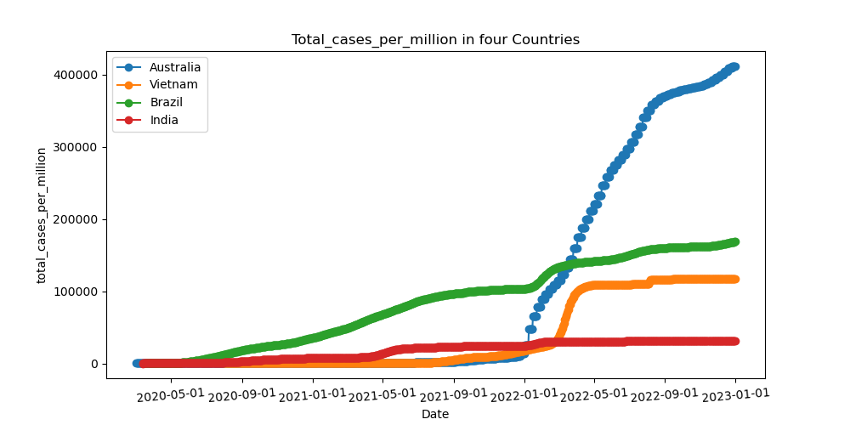
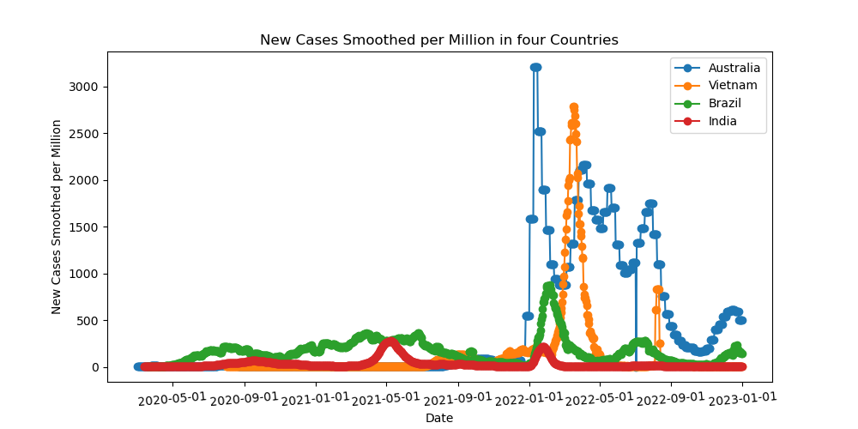
Total +New cases_per million
Brazil led total cases until the end of 2021, after which Australia took the lead in total cases, followed by other countries.
New_case_smoothed: Australia has the highest rate(3000), followed by Brazil, India, and Vietnam.

Slide 6
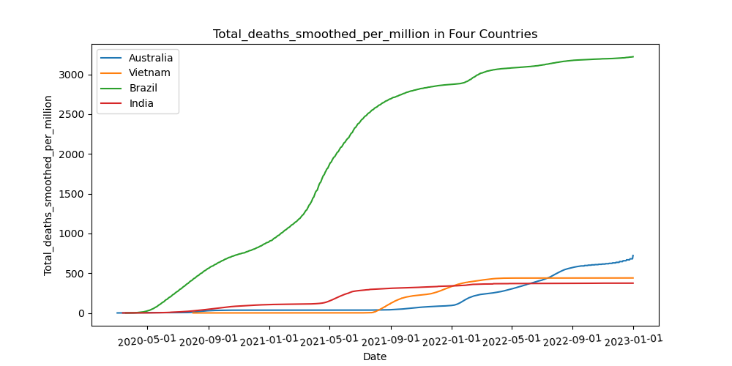
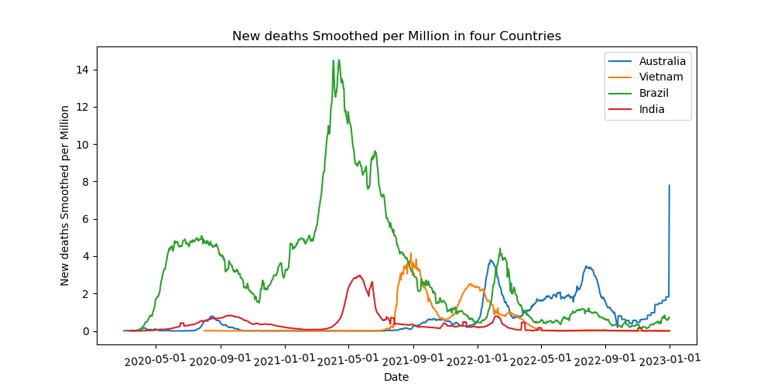
Total +New deaths_per_million
per_million
Brazil highest rate, Australia, India, and Vietnam follow.
Brazil :led with the highest rate until the middle of 2022.
Australia took the lead among other countries, reaching 8 new deaths per million at the beginning of 2023.

Slide 7
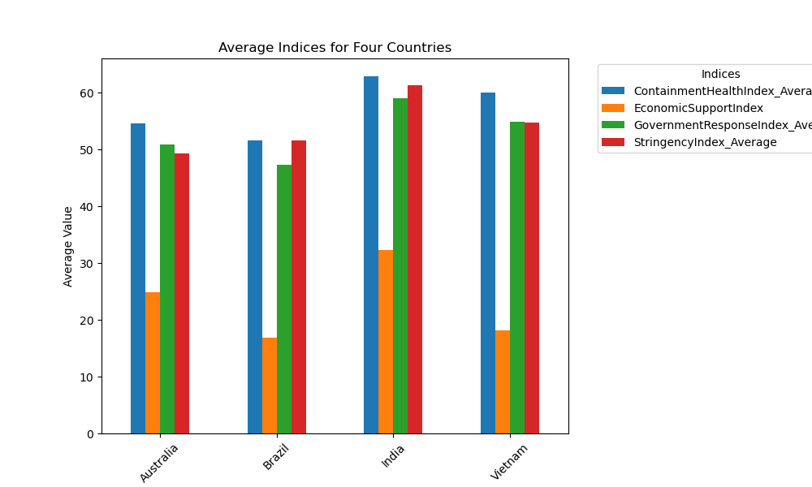
Government Response Efficiency
India exhibited higher scores in all indices, indicating more substantial governmental efforts.
Vietnam demonstrated a balance, with moderate values across the indices

Slide 8
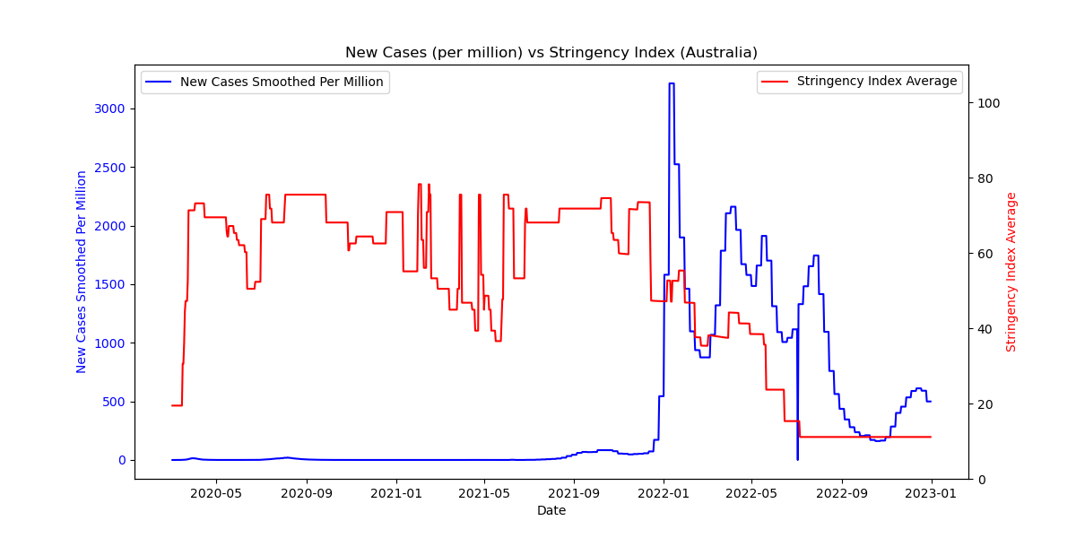
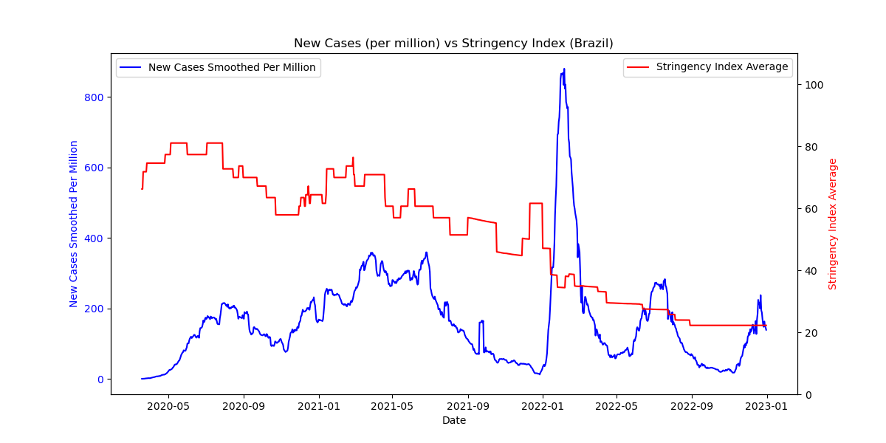
Government Response Efficiency
New cases per million are inversely correlated with the Stringency Index, as stringency increased from mid-2021.
The higher the Stringency Index in Australia, the lower the number of new cases.
In Brazil, with the strictest measures in place, the number of new cases per million easily dropped to < 200 per million.

Slide 9
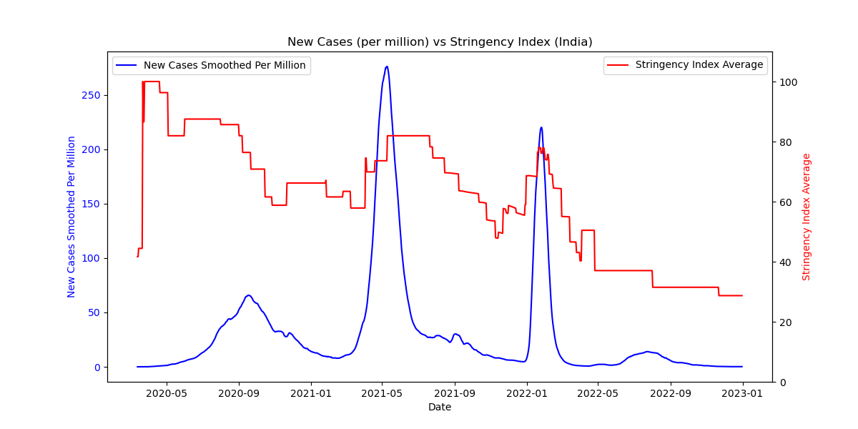
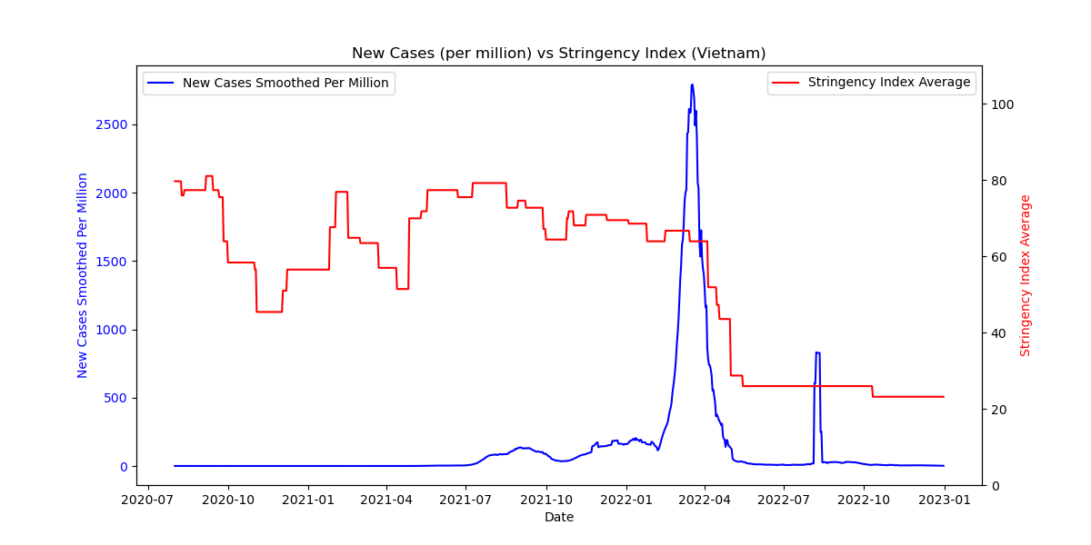
Government Response Efficiency
India highest Stringency Index among the specified countries, indicates that India has implemented a more comprehensive set of stringent measures in response to the COVID-19 pandemic.

Slide 10
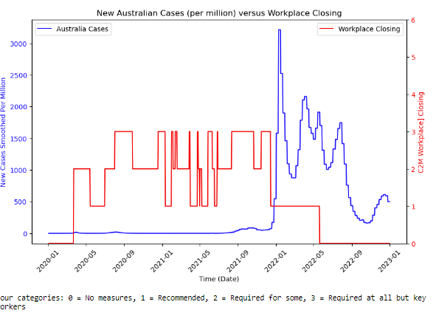
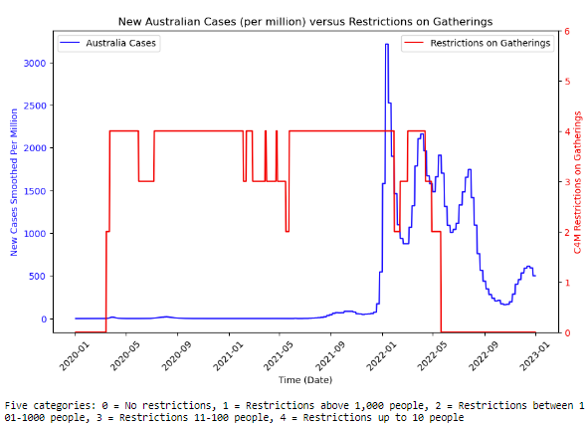
Containment and Closure Policies Efficiency
Restrictions on gatherings did not prevent new infections spiking.
Rate of Infections increased rapidly shortly after Workplace Closing Restrictions eased.

Slide 11
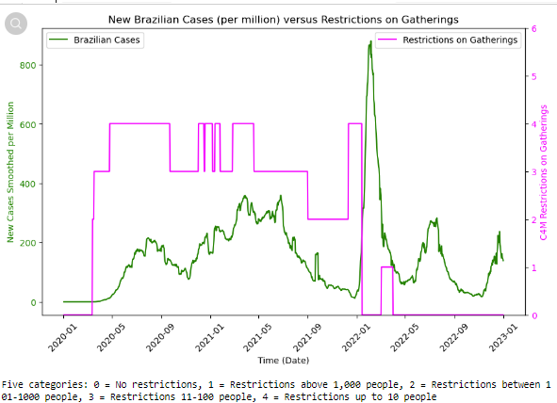
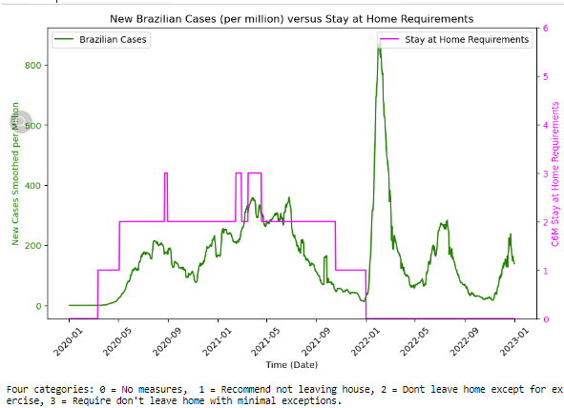
Containment and Closure Policies Efficiency
Imposing the Stay at Home Requirement has not reduced the number of new infections.
A new spike in infections emerges immediately after easing the restrictions on gatherings.

Slide 12
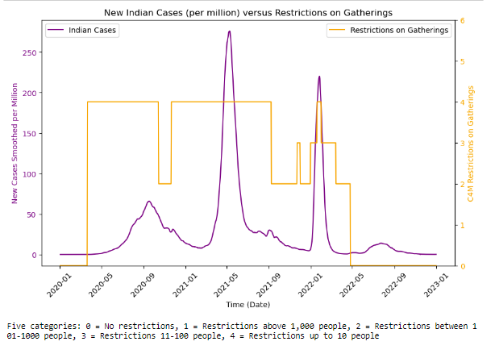
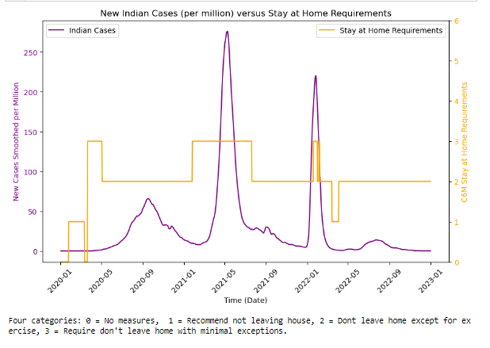
Containment and Closure Policies Efficiency
The Stay at Home requirements appears to have been marginally effective sometimes.
The heavy Restrictions on Gatherings does not appear to reduced new infections.

Slide 13
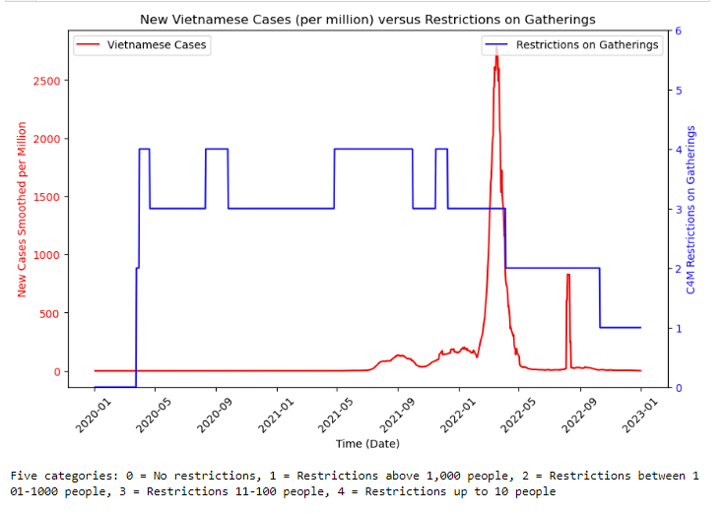
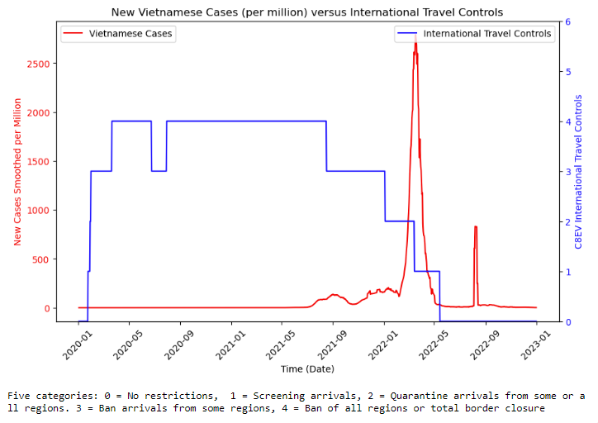
Containment and Closure Policies Efficiency
Heavy Restrictions on International Travel Controls appear to have assisted in suppressing new cases until the new spike.
Heavy Restrictions on Gatherings appear to have assisted in suppressing new cases until the new spike.

Slide 14
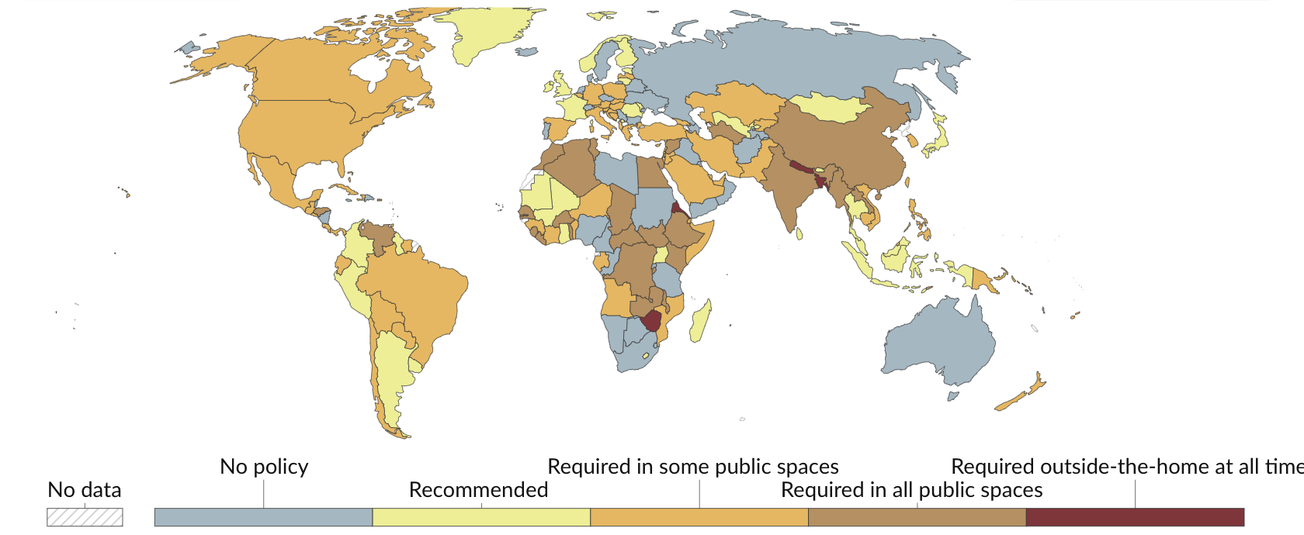
Health policies efficiency
The countries that used the face-covering and contact tracing policies by the end of 2023, had a significant influence on the decline in the number of fatalities per million due to the heavy restrictions placed on wearing masks and getting tested. With Brazil, India and Vietnam having open public testing and Australia, implementing testing for anyone who showed symptoms.

Slide 15
Health policies efficiency
India throughout the years had the best health policy efficiency during Covid, keeping transmission of infection low which worked greatly in keeping the total and new death cases low, followed by Vietnam, Australia, and then Brazil

Slide 16
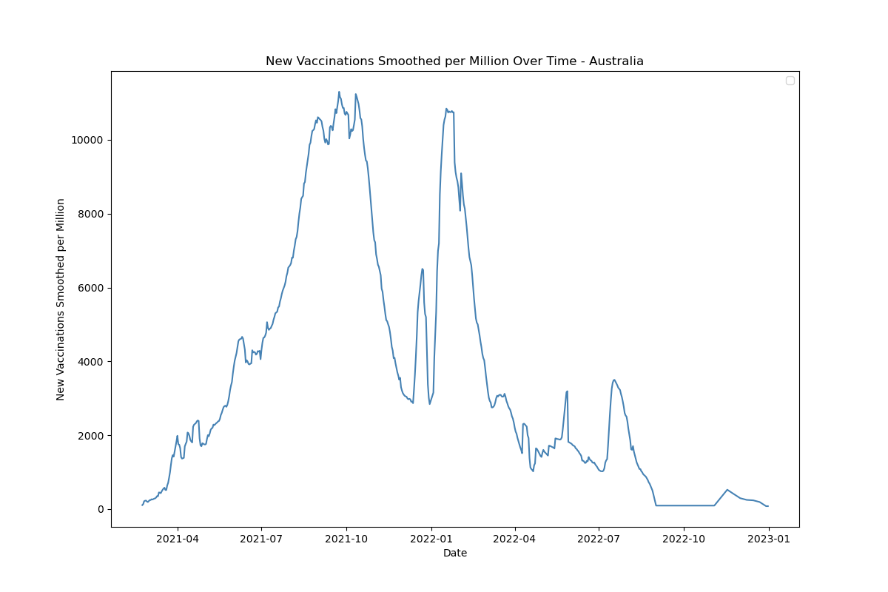
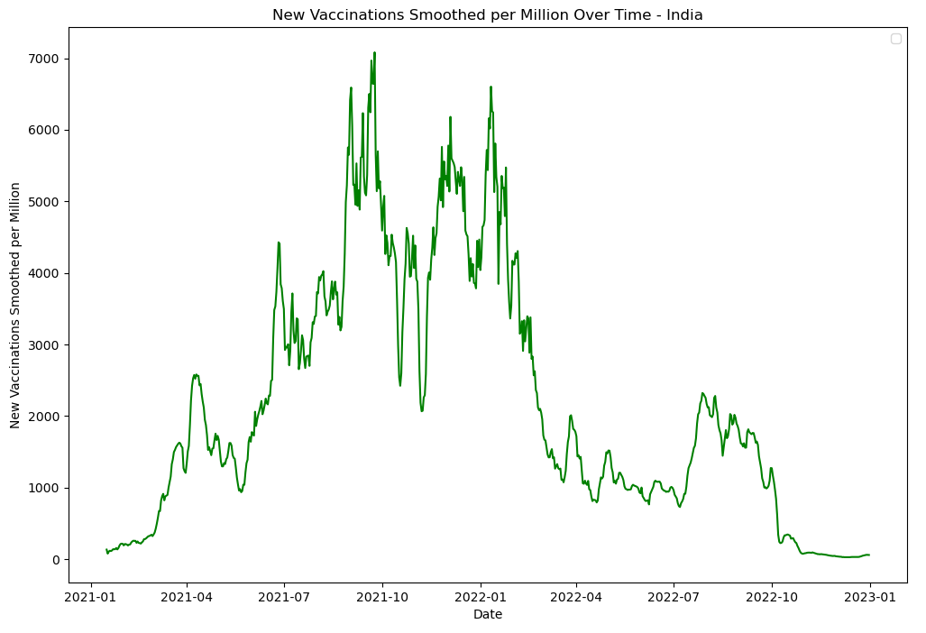
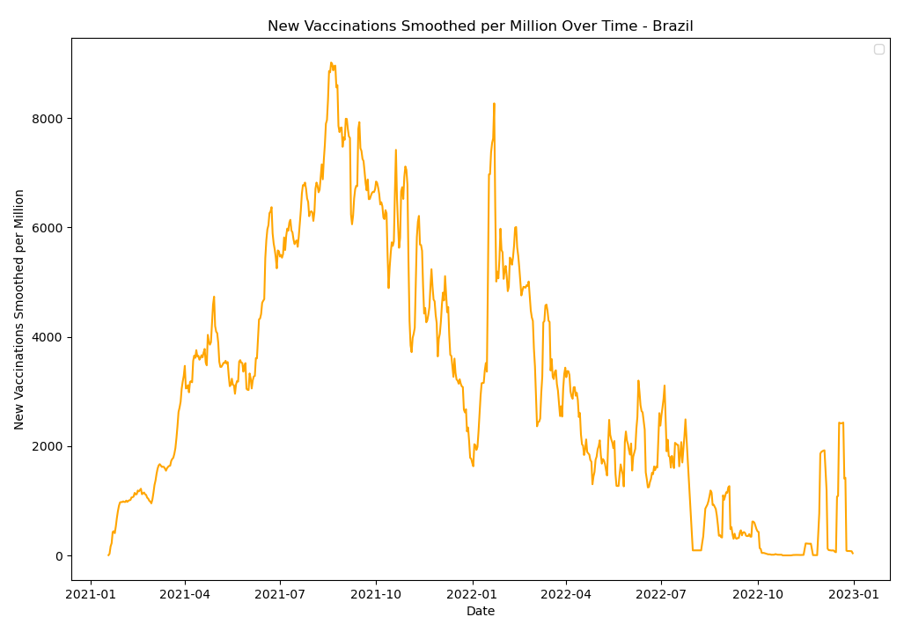
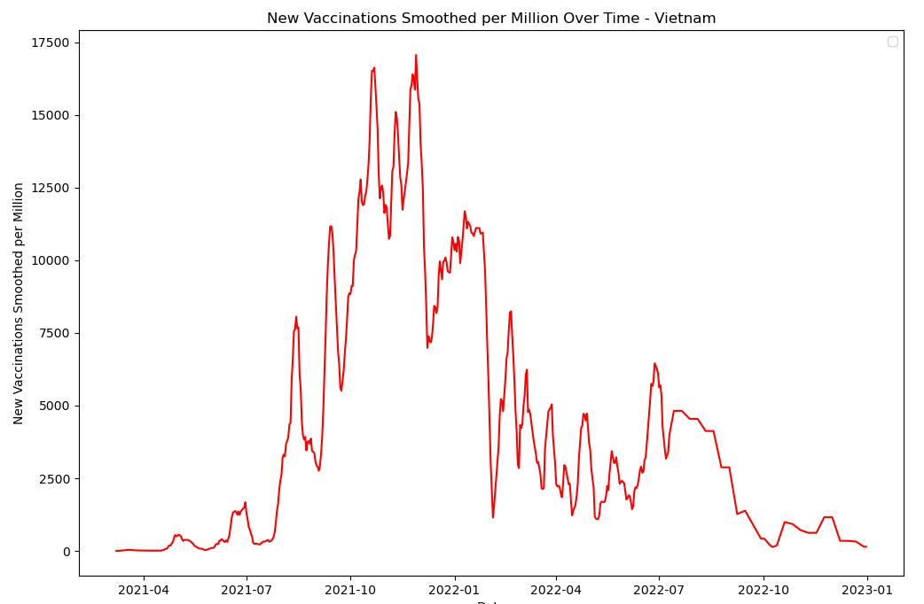
Vaccinations rollout

Slide 17
Economic Assistance Impact
Country | % population living in extreme poverty | Hospital beds per 1,000 people
Australia | 0.5 | 3.84
Brazil | 3.40 | 2.2
India | 21.2 | 0.53
Vietnam | 2.00 | 2.6
India: Highest extreme poverty percentage posed challenges in vaccination rollout.
India: Lowest hospital beds per 1,000 people emphasized potential strain on healthcare infrastructure.

Slide 18
Economic Assistance Impact
Country | % population living in extreme poverty | Hospital beds per 1,000 people | Emergency investment in healthcare (USD) | Investment in vaccines (USD)
Australia | 0.5 | 3.84 | 3,876,215,144.83 | 4,703,229,757.98
Brazil | 3.40 | 2.2 | 152,598,230,724.82 | 148,930,783.00
India | 21.2 | 0.53 | 1,264,200,000.00 | 130,205,680.00
Vietnam | 2.00 | 2.6 | 86,180.00 | 53,966.00
India: Highest extreme poverty percentage posed challenges in vaccination rollout.
India: Lowest hospital beds per 1,000 people emphasized potential strain on healthcare infrastructure.
Brazil led in emergency healthcare investment; Australia prioritized vaccine investment, highlighting diverse national strategies and priorities.

Slide 19
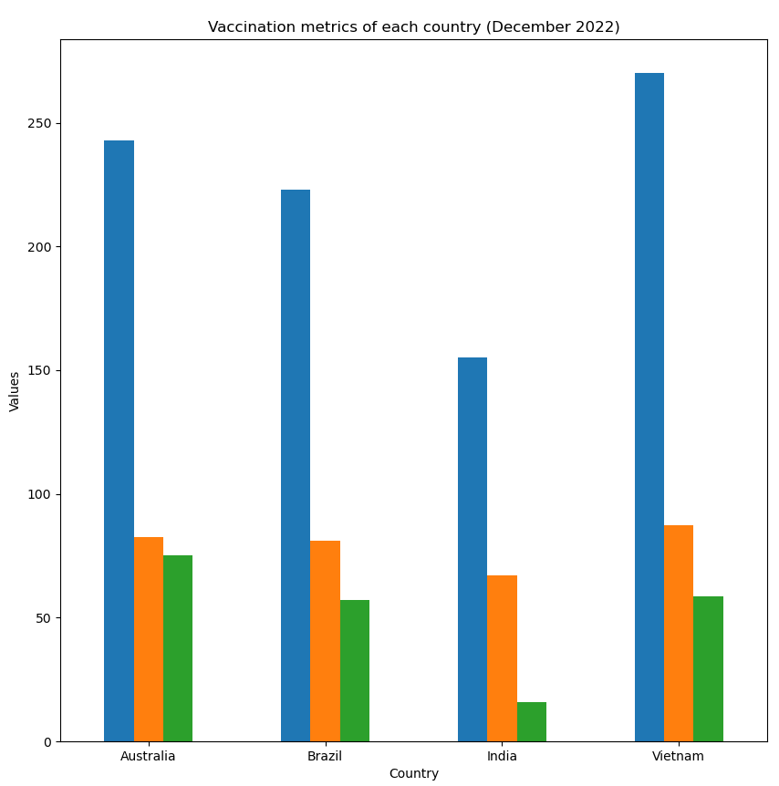
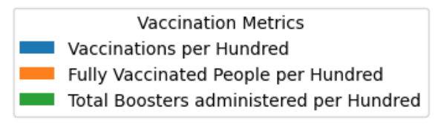
Outcome: Vaccinations
Australia, Brazil, and Vietnam exceed 80% fully vaccinated; India lags at 67%.
Notable differences in total boosters: Australia at 75%, India at 15%.
Highlighting diverse national strategies in responding to evolving health challenges

Slide 20
Key takeaways
India has the highest Stringency Index due to stringent COVID-19 measures like lockdowns, compared to lower indices in Brazil and Australia, suggesting less strict approaches, with the index reflecting the degree of measures, not their effectiveness.
Government and health organisations worldwide implemented a range of policies to control and contain the spread of COVID-19. While the four countries examine showing similar efficacy in stemming new infections, there were some significant differences.
The countries that followed rigorous face covering and and contact tracing policies had a significant beneficial influence on the decline in the number of fatalities per million.
Policymakers should focus on a holistic approach, addressing economic and healthcare infrastructure challenges. Collaborative efforts at a global level are crucial for addressing healthcare disparities and ensuring comprehensive vaccination coverage.

Slide 21
Questions?

Slide 22
Thank you!

